Slide 1



Bayesian analysis of EFTs with Jupyter notebooks
Dick Furnstahl
Virtual DNP Meeting, October 2020
Special thanks to my BUQEYE colleagues!
https://buqeye.github.io
This talk: [pptx][pdf]

Slide 2
What is a Jupyter notebook? (cf. Mathematica notebook)
Executes Python (Anaconda recommended; all free!) but also other languages
Displays in your browser (can run in the cloud through Binder! Example below)
Tutorials available from datacamp, dataquest, YouTube, …

Slide 3
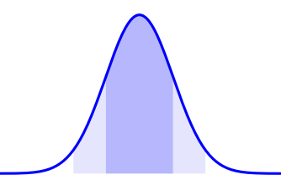
Overview of Bayesian methods
Bayesian statistics is a powerful framework for (chiral) EFT uncertainty quantification (UQ). Everything is a pdf.

Slide 4
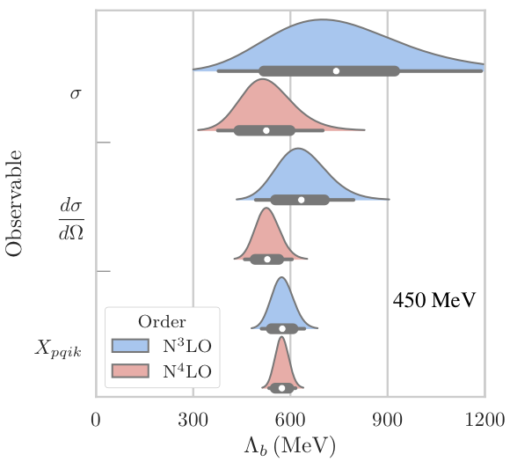
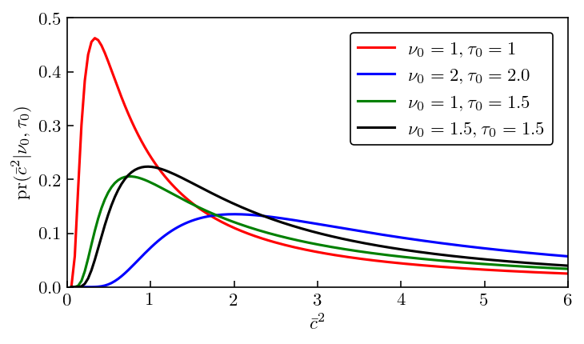
Overview of Bayesian methods
Bayesian statistics is a powerful framework for (chiral) EFT uncertainty quantification (UQ). Everything is a pdf.
3P0 channel at N3LO, np sector
pr(Λ_{b} | y_{th}, I) ⇒ pdf of breakdown scale of EFT expansion
LENPIC arXiv:1907.03608
pr(θ | y_{exp} , Σ_{exp} , Σ_{th} , I) ⇒
pdf of model parameters θ given data y_{exp} and experiment/theory errors Σ
pr(δy_{th} |y_{th} , I) ⇒ pdf of theory error δy_{th} given theory calculations y_{th}
Prior for what is natural

Slide 5
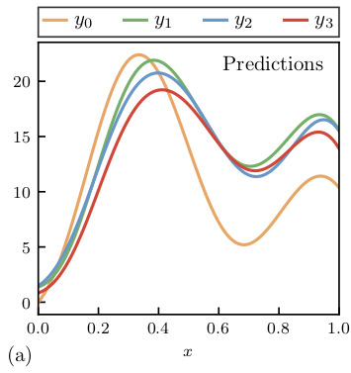
Overview of Bayesian methods
Bayesian statistics is a powerful framework for (chiral) EFT uncertainty quantification (UQ). Everything is a pdf.
EFT theory discrepancy model from the convergence pattern and naturalness priors; assumptions explicit.
Model checking is an essential part of Bayesian UQ.
Order-by-order failure
Order-by-order success
Toy model for an observable y(x); e.g., cross section vs. energy, order-by-order in EFT.

Slide 6
Overview of Bayesian methods
Bayesian statistics is a powerful framework for (chiral) EFT uncertainty quantification (UQ). Everything is a pdf.
EFT theory discrepancy model from the convergence pattern and naturalness priors; assumptions explicit.
Model checking is an essential part of Bayesian UQ.
Correlations matter (in many ways). Gaussian process truncation error model for continuous correlations.

Slide 7
Overview of Bayesian methods
1S0 channel at N3LO
np sector
Bayesian statistics is a powerful framework for (chiral) EFT uncertainty quantification (UQ). Everything is a pdf.
EFT theory discrepancy model from the convergence pattern and naturalness priors; assumptions explicit.
Model checking is an essential part of Bayesian UQ.
Correlations matter (in many ways). Gaussian process truncation error model for continuous correlations.
Bayesian: sample for parameter estimation and the propagation of uncertainties; use emulators (like EC)!
Using priors and truncation errors minimizes overfitting and dependence on how much data is used; posteriors can be used for diagnostics.
3P0 channel at N3LO np sector
Wesolowski et al., J. Phys. G (2019)
pr(θ | y_{exp} , Σ_{exp} , Σ_{th} , I) ⇒
pdf of model parameters θ given data y_{exp} and experiment/theory errors Σ

Slide 8
BUQEYE Collaboration (“Bayesian Uncertainty Quantification: Errors for Your EFT”)
Christian Drischler
Dick Furnstahl
Harald Grießhammer
Natalie Klco
Jordan Melendez
Daniel Phillips
Matt Pratola
Sarah Wesolowski
Xilin Zhang
https://buqeye.github.io
The buckeye is the state tree of Ohio!
Papers and software (including Jupyter notebooks for figures)
BUQEYE philosophy for Bayesian analysis via notebooks:
All assumptions explicit, with model checking and able to be checked externally
Jupyter notebook(s) that reproduce all figures in BUQEYE papers (data provided)
Open source, available on Github (or equivalent). Forks are encouraged!
Recent highlight: “Effective Field Theory Truncation Errors and Why They Matter,”
Jordan Melendez PhD thesis 2021 Dissertation Award in Nuclear Physics (SA.00003 11:42am)

Slide 9
Reference scale, expansion parameter, order of calculation
Order-by-order calculations
Extract coefficients
→
Update hyperparameters
Compute posterior and error bands
Note: If n_{c} ≫ 1, the posterior for y becomes a normal distribution.
From https://buqeye.github.io/

Slide 10
Recent BUQEYE notebooks for EFT UQ papers
Quantifying correlated truncation errors in effective field theory, J. Melendez, rjf, D. Phillips, M. Pratola, and S. Wesolowski, Phys. Rev. C 100, 044001 (2019) [notebooks]
How well do we know the neutron-matter equation of state at the densities inside neutron stars? A Bayesian approach with correlated uncertainties, C. Drischler, rjf, J. Melendez, and D. Phillips, Phys. Rev. Lett. (in press). [notebooks]
Quantifying uncertainties and correlations in the nuclear-matter equation of state, C. Drischler, J. Melendez, rjf, and D Phillips, Phys. Rev. C (in press). [notebooks]
Efficient emulators for scattering using eigenvector continuation, rjf, A. Garcia, P. Millican, and X. Zhang, Phys. Lett. B 809, 135719 (2020). [notebooks]
Designing Optimal Experiments: An Application to Proton Compton Scattering, J. Melendez, rjf, H. Grießhammer, J. McGovern, D. Phillips, and M.T. Pratola, arXiv:2004.11307. [notebooks] See Harold Grießhammer talk following this one.

Slide 11
Correlated theory errors for EOS properties
C. Drischler et al. (arXiv:2004.07232 PRL, in press)
at 0.17 ± 0.01 fm³
(SD.00006 11:30am)
Correlated GP treatment gives better estimates for truncation errors and clean propagation of uncertainties to derived quantities.
See also comparisons to GW and NICER posteriors!

Slide 12
Summary points and more information
Jupiter notebooks and Python are great tools for nuclear physics UQ
Bayesian methods for EFT and other theory errors (combined with experiment)
Many examples from the BUQEYE collaboration
We strongly advocate that every paper have a notebook for reproducing figures
Github repositories with notebooks for learning Bayesian statistics for physics
BAYES 2019 (TALENT course): https://nucleartalent.github.io/Bayes2019/
Furnstahl course at Ohio State: https://furnstahl.github.io/Physics-8805/

Slide 13
BAND (Bayesian Analysis of Nuclear Dynamics)
An NSF Cyberinfrastructure for Sustained Scientific Innovation (CSSI) Framework (from 7/2020)
Look to https://bandframework.github.io/ over the next five years!
Registration for Virtual ISNET 8 and for the First Annual BAND Camp is open. The website lists confirmed speakers for both events.
https://indico.frib.msu.edu/event/21/

Slide 14
Thank you!

